Slide 1


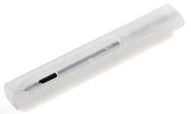
Revolutionary Irrigation Technology to Mitigate Climate Change Hazards

Slide 2
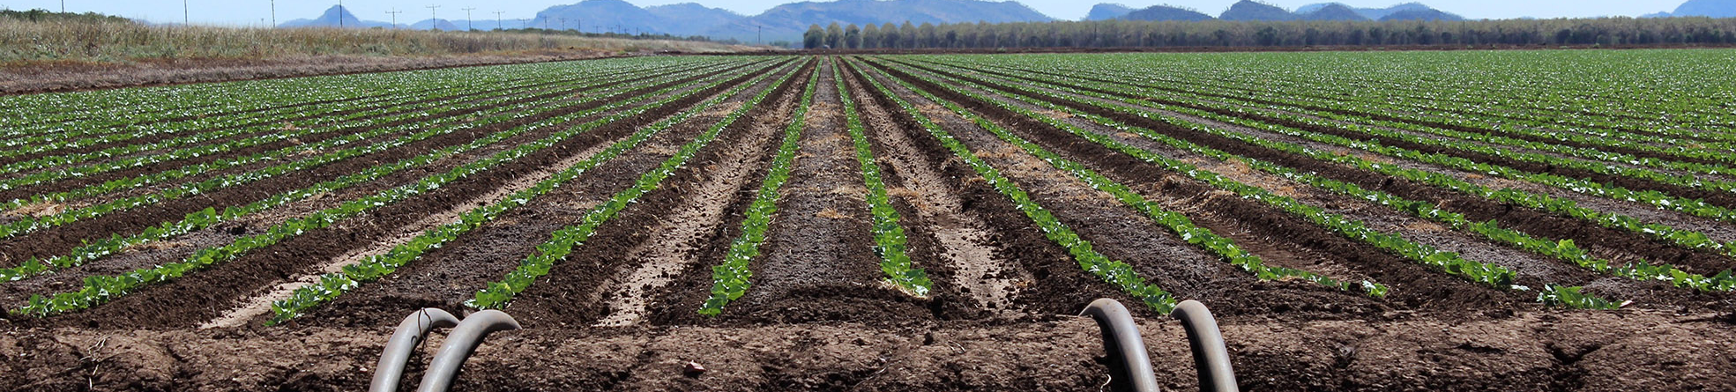
70%
of annual water withdrawals
goes to Agriculture
85%
of global irrigation is carried out by wasteful flood
Sustainable farming is a global necessity
Source: Aquastat FAO, World bank

Slide 3





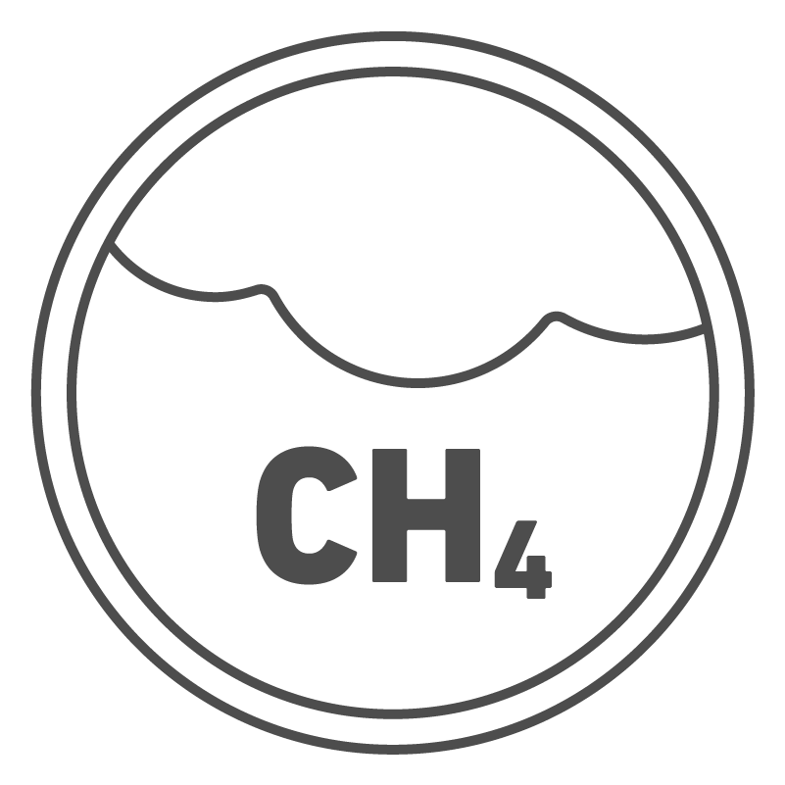

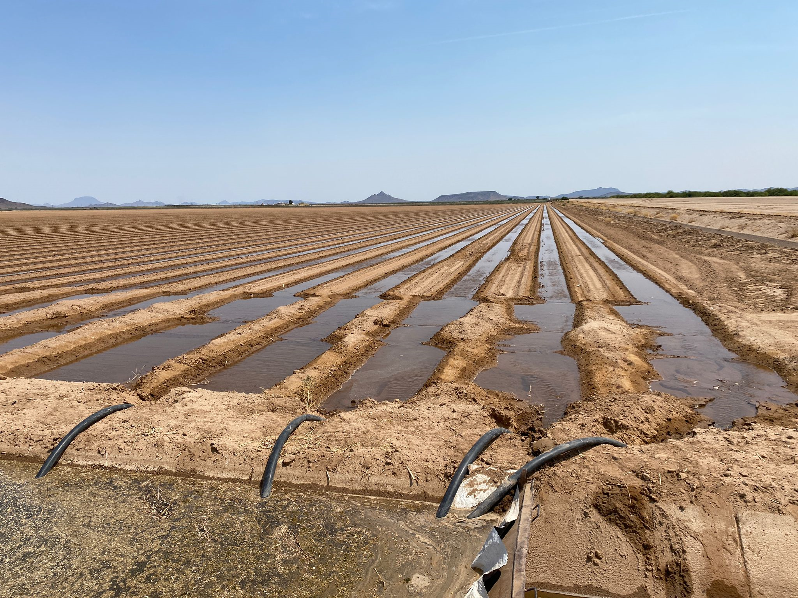
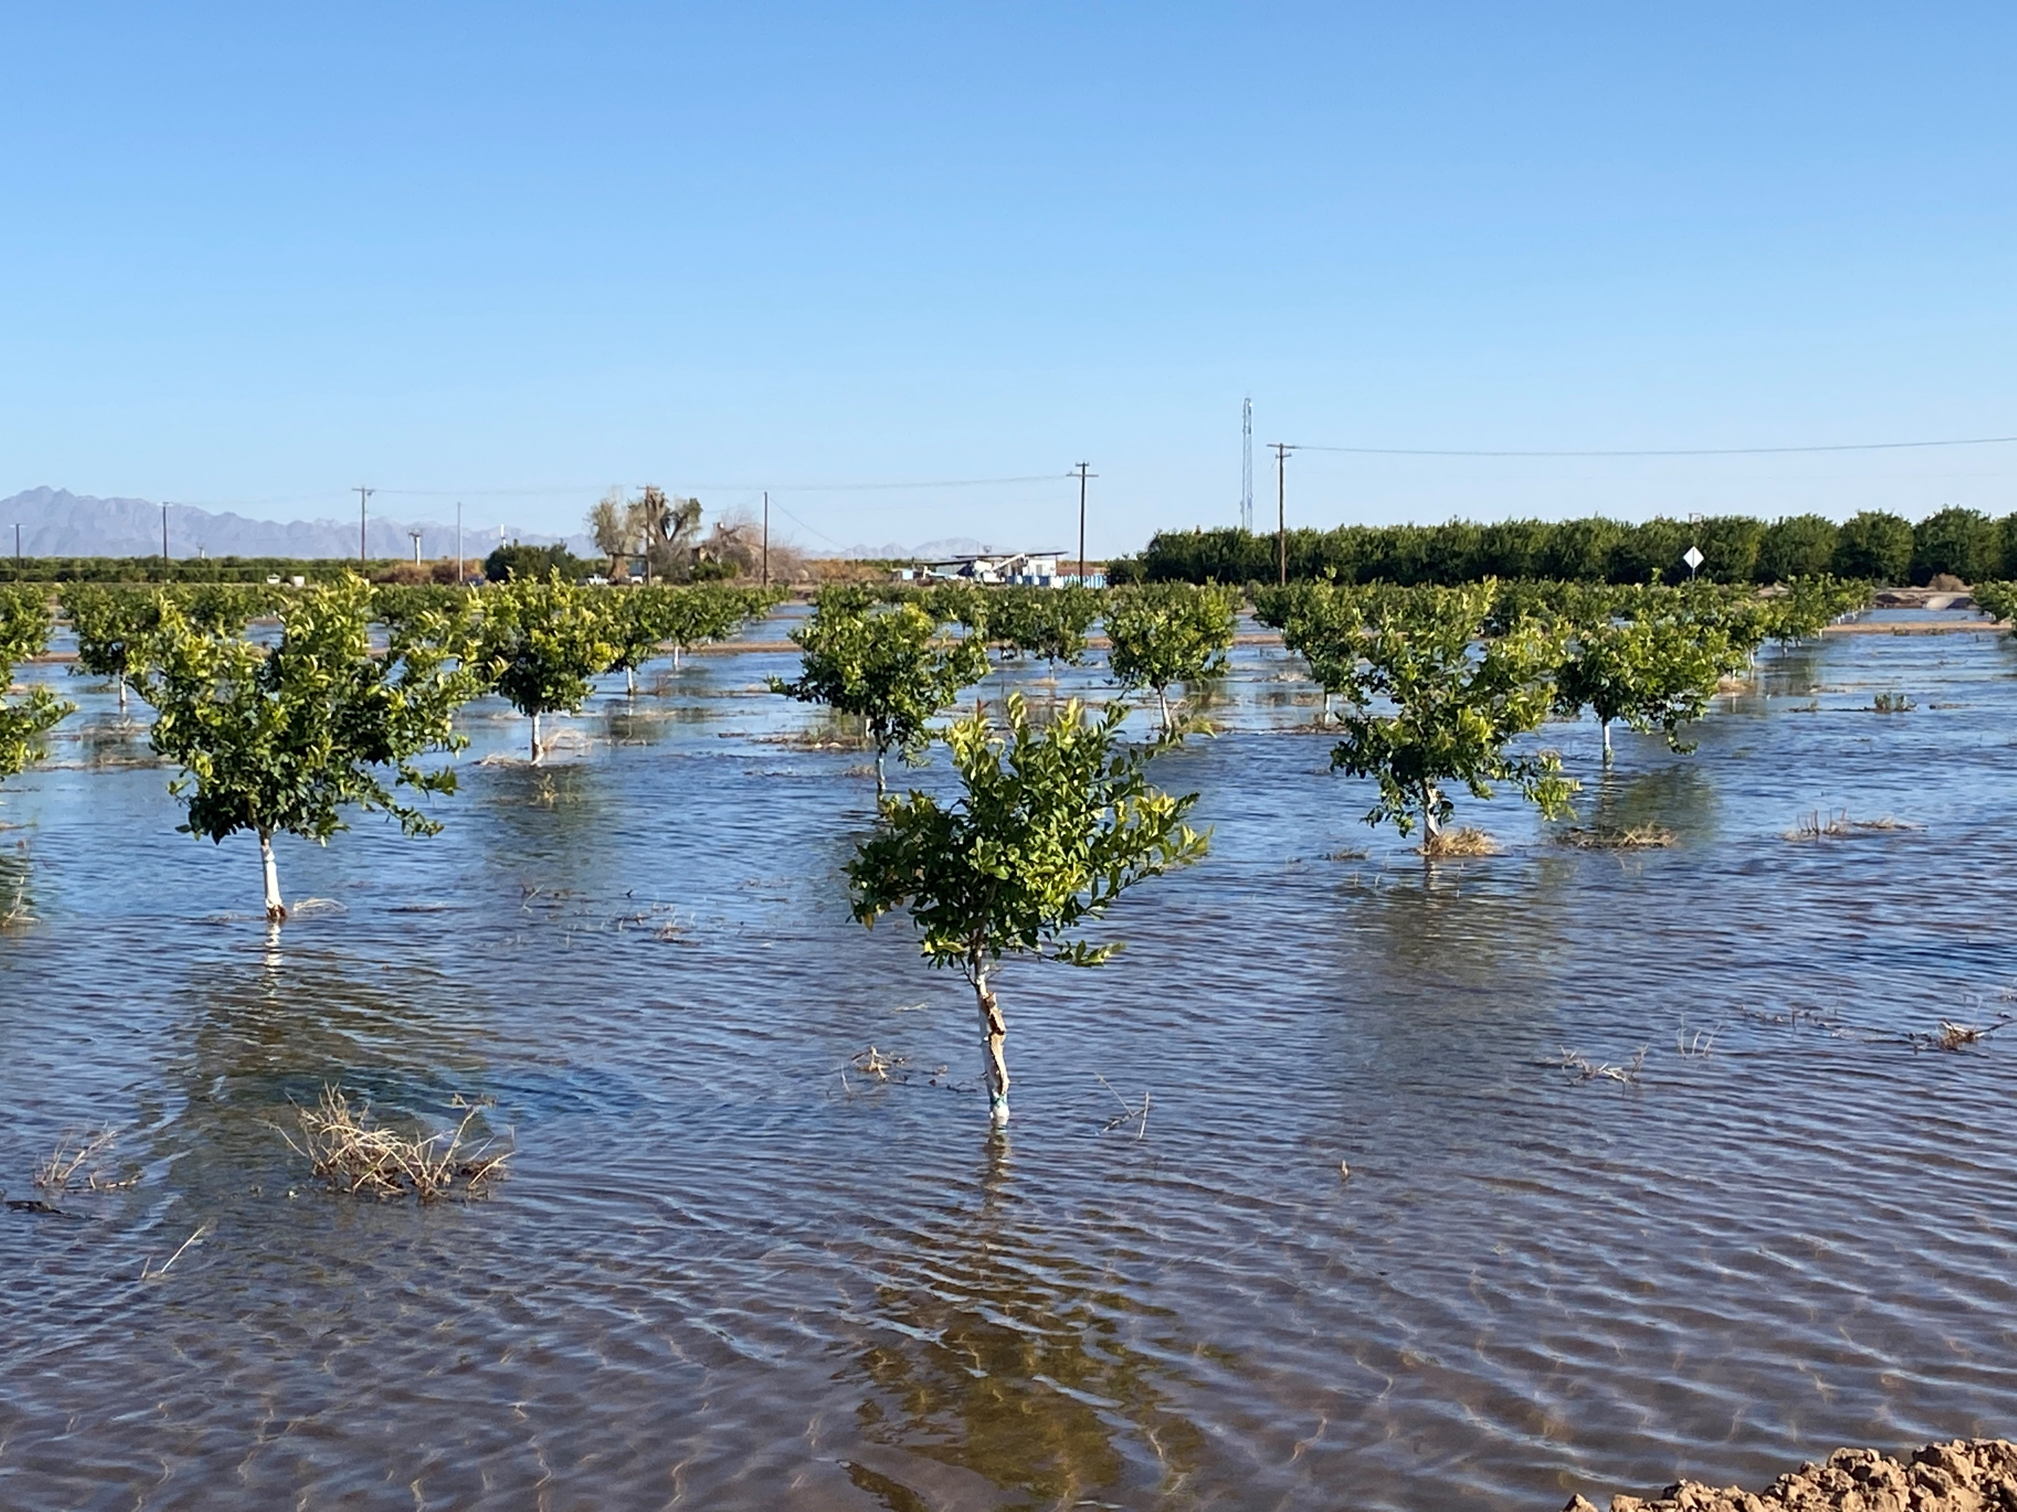
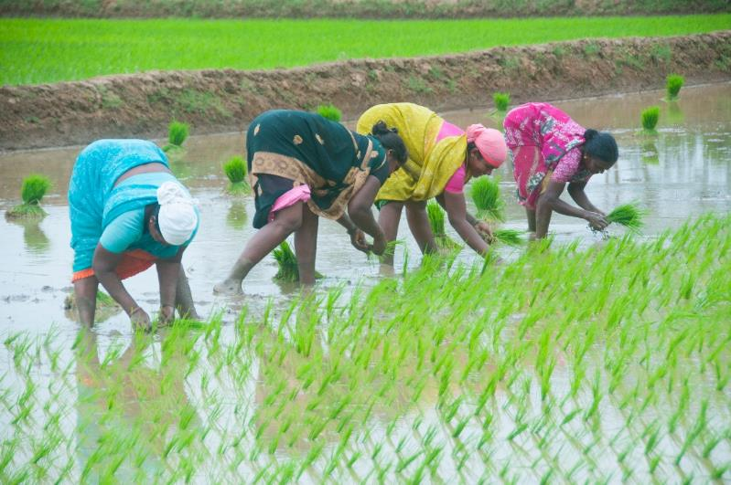
Flood Irrigation is No Longer Sustainable
Water Waste
﻿Lower Yield
Fertilizer
Overuse
Greenhouse
Gases
Soil
Erosion
Methane
Hard
Labor

Slide 4
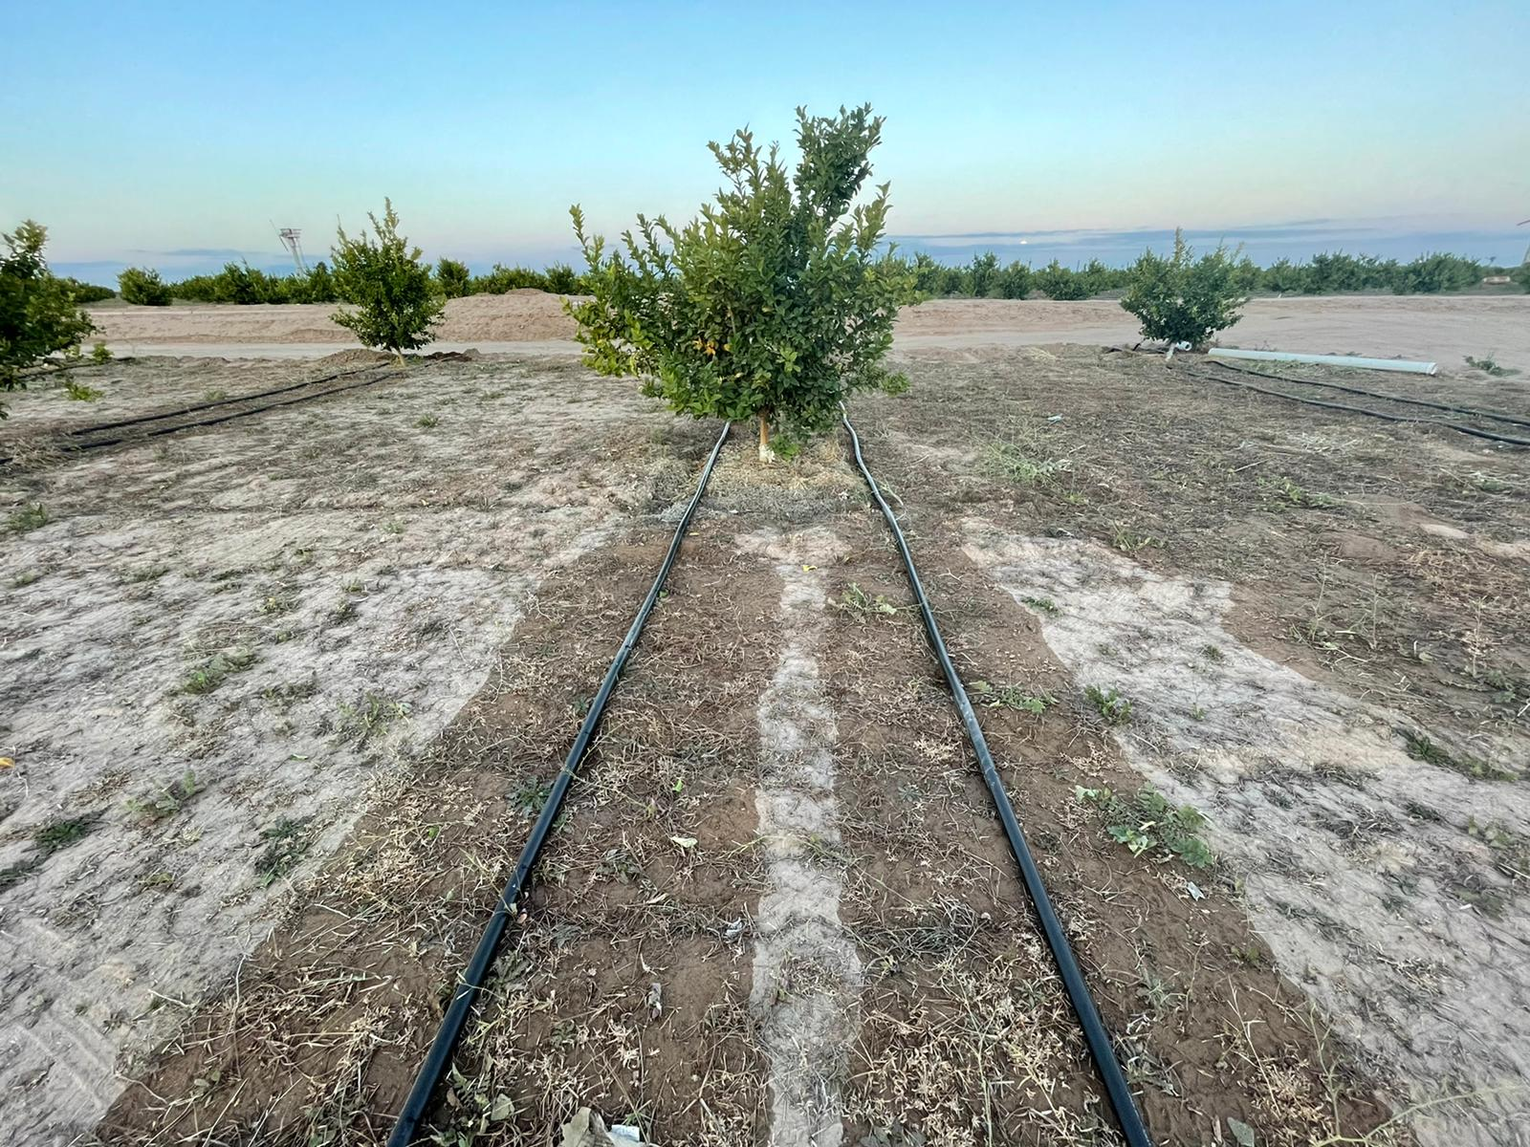

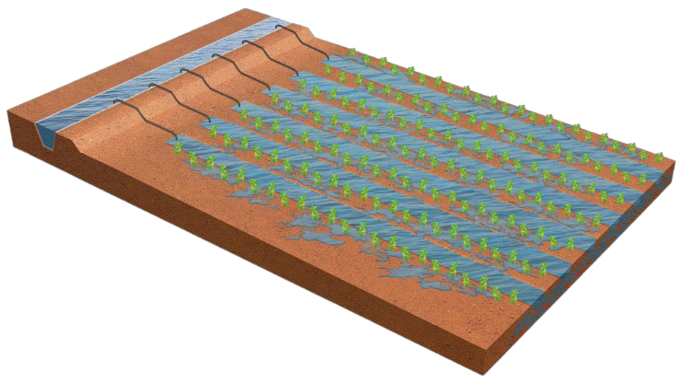
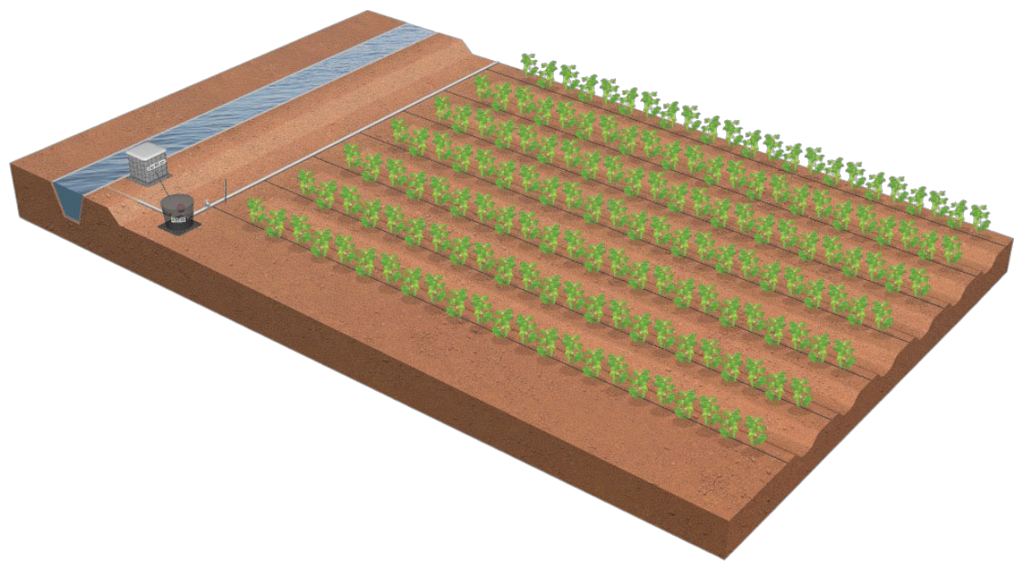
N-Drip Transforms Flood to Gravity-Powered Micro-Irrigation
Flood
N-Drip
Citrus in Yuma, Arizona - Before and after the transition from flood to N-Drip
Proprietary and Confidential. All Rights Reserved.

Slide 5
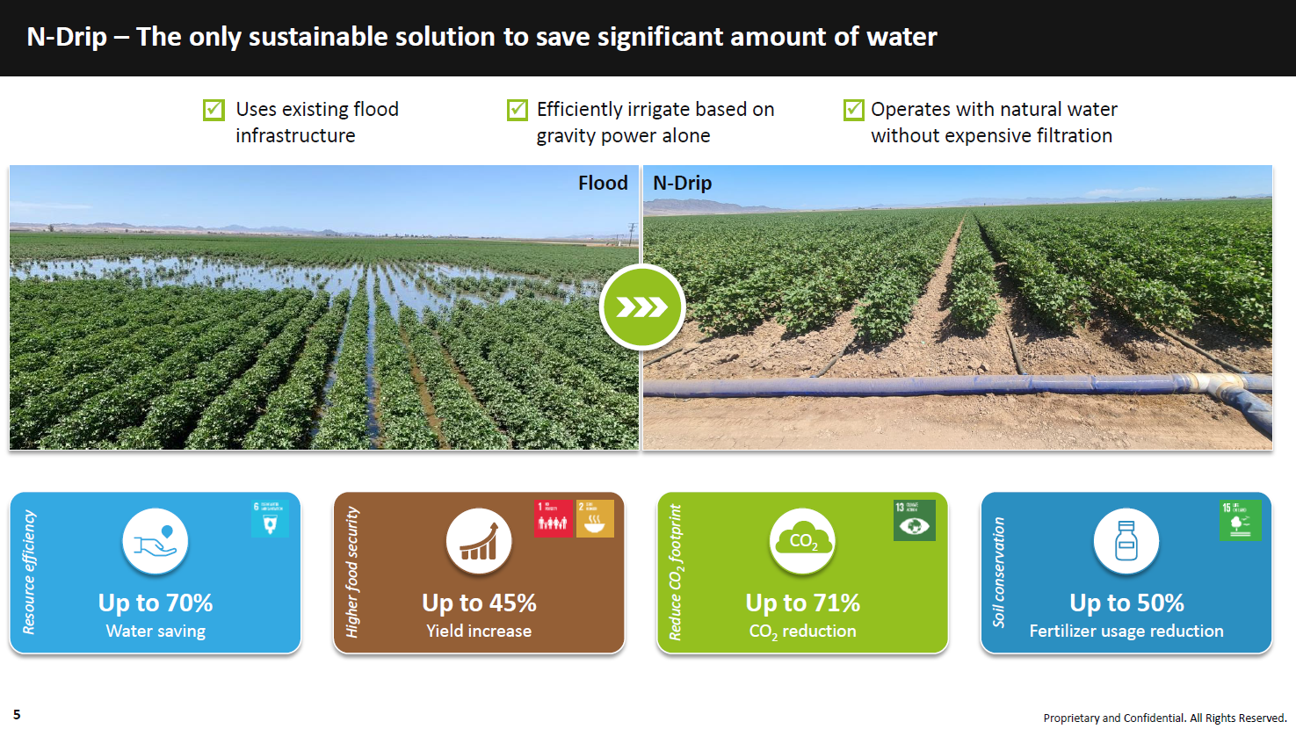

Slide 6
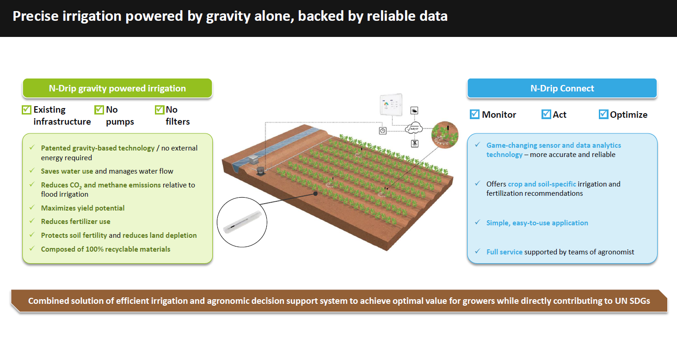

Slide 7
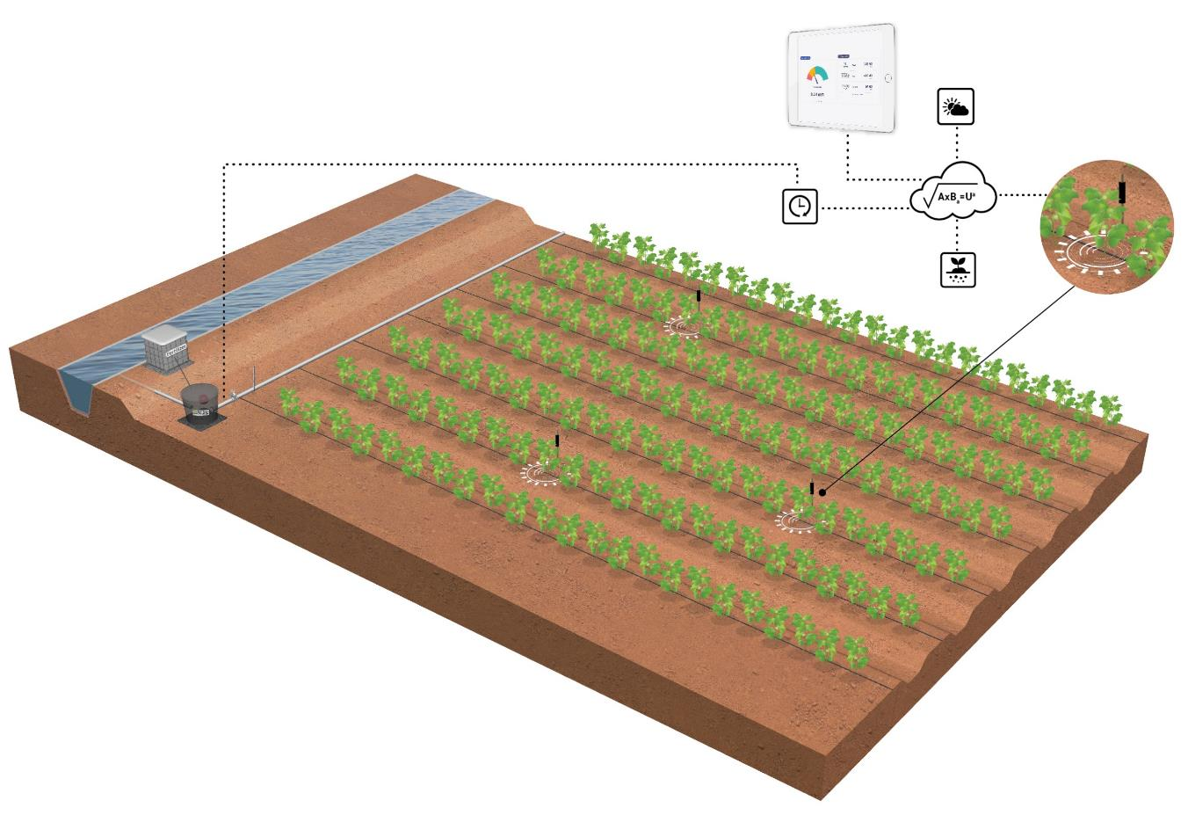








N-Drip Provides Precise Irrigation Powered by Gravity Alone, Backed by Reliable Data
N-Drip Gravity Powered Irrigation
Existing
Infrastructure
No
Pumps
No
Filters
N-Drip Connect
Monitor
Act
Optimize
Saves Water
Up to 60% saving in water use compared to flood
Maximizes Yield Potential
30 percent greater yield than a comparable flood-irrigated field
Reduces Fertilizer Use
Up to 50 percent of total fertilizer costs, and reduction in algal blooms and groundwater contamination
Reduces Emissions
Up to 80% reduction in CO₂ + CH₄ emissions
Proprietary and Confidential. All Rights Reserved.

Slide 8
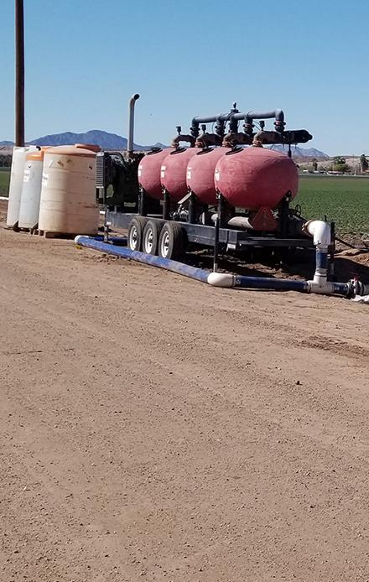
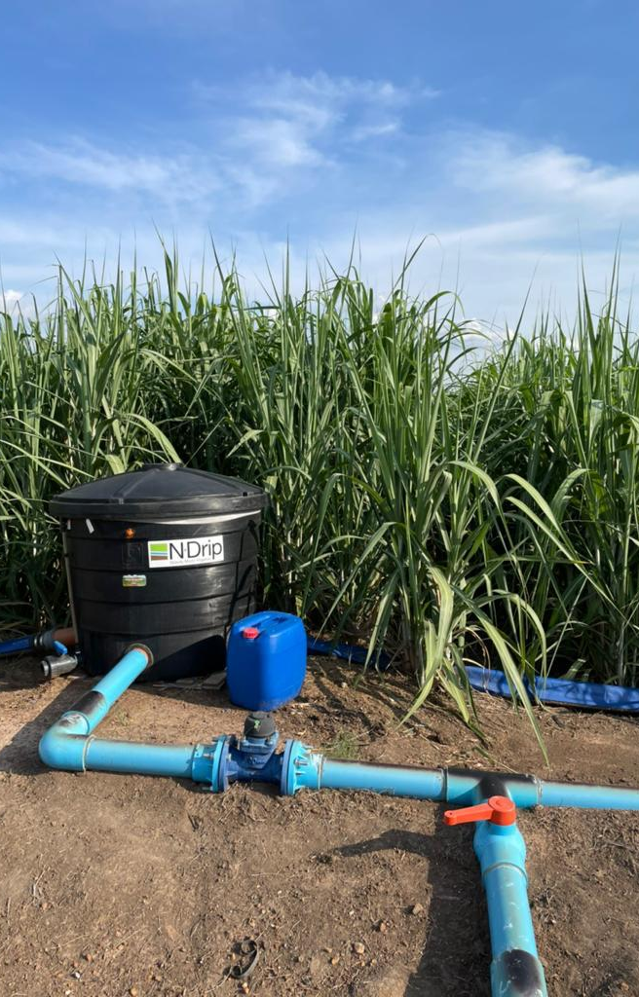
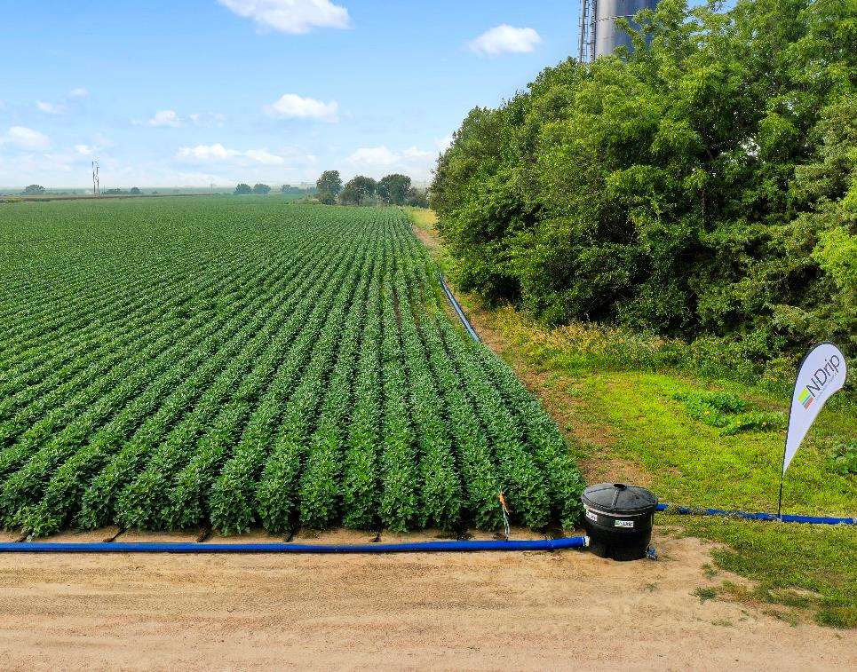
A Picture is Worth 1,000 Words…
Simple and affordable infrastructure vs. pressurized drip
Higher yield vs. flood, using 50% less water
N-Drip
>$500 per acre
Equipment:
water tank, valves
 | N-Drip | Flood
Irrigation (AF/acre) | 1.53 | 3.05
Co2 Emissions (Kg/ton) | 54 | 352
Yield (Bu/acre) | 89.5 | 72
High-pressure Drip
<$2,000 per acre*
Equipment:
filters, pumps, valves
*Not including cost of energy
Proprietary and Confidential. All Rights Reserved.

Slide 9
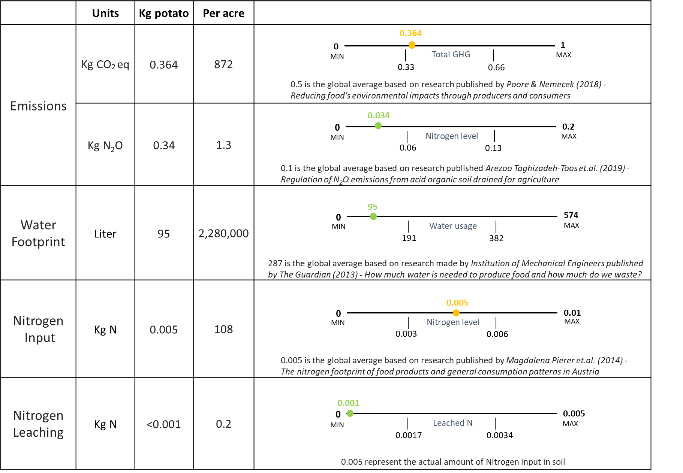
Environmental ID - Generated by N-Drip Connect
Case study: Reducing the carbon footprint in Potato
Proprietary and Confidential. All Rights Reserved.
Notes:
https://www.science.org/doi/10.1126/science.aaq0216
https://bg.copernicus.org/articles/16/4555/2019/
https://www.theguardian.com/news/datablog/2013/jan/10/how-much-water-food-production-waste
https://www.sciencedirect.com/science/article/abs/pii/S0306919214001122
https://www.sciencedirect.com/science/article/abs/pii/S0306919214001122

Slide 10



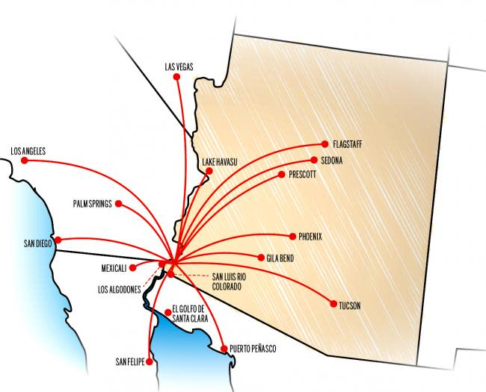
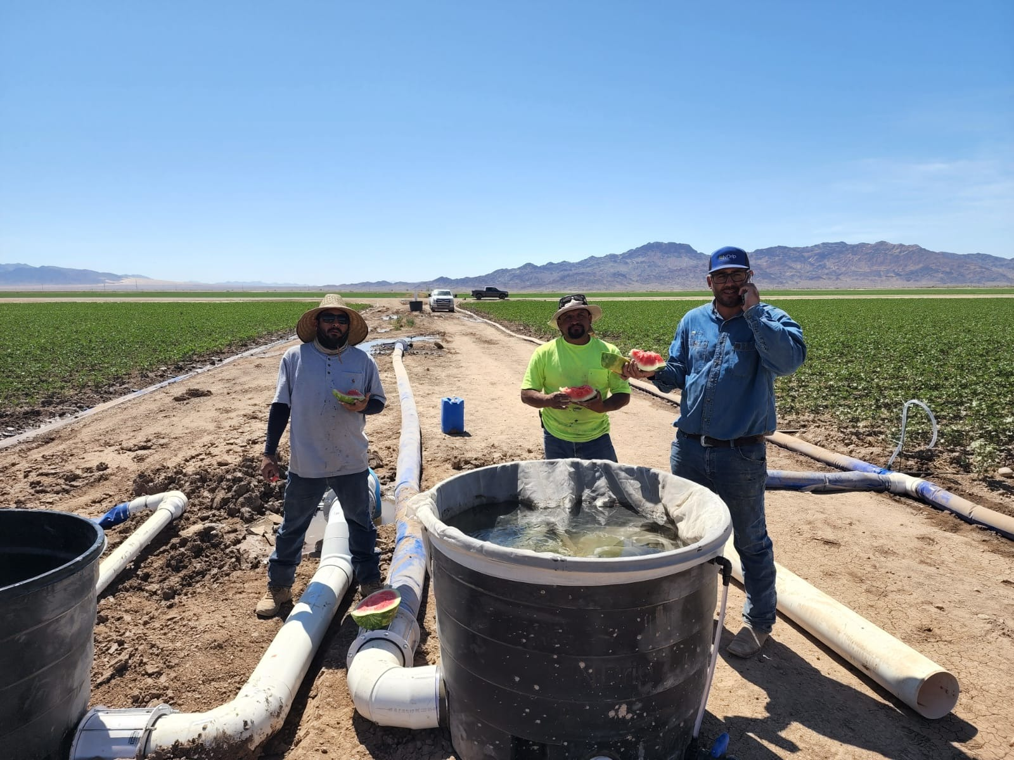

Arizona is Home For N-Drip in North America

Slide 11
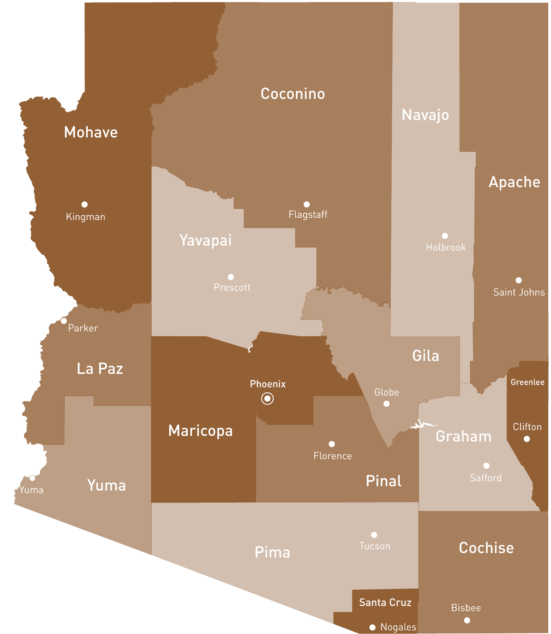

N-Drip in Arizona
CRIT Team
Head office
Parker | 3500 acres
Casa Grande | 500 acres
Buckeye | 500 acres
Yuma | 5000 acres
Eloy | 500 acres
Tucson | 100 acres
Yuma Team
Central Arizona Team

Slide 12
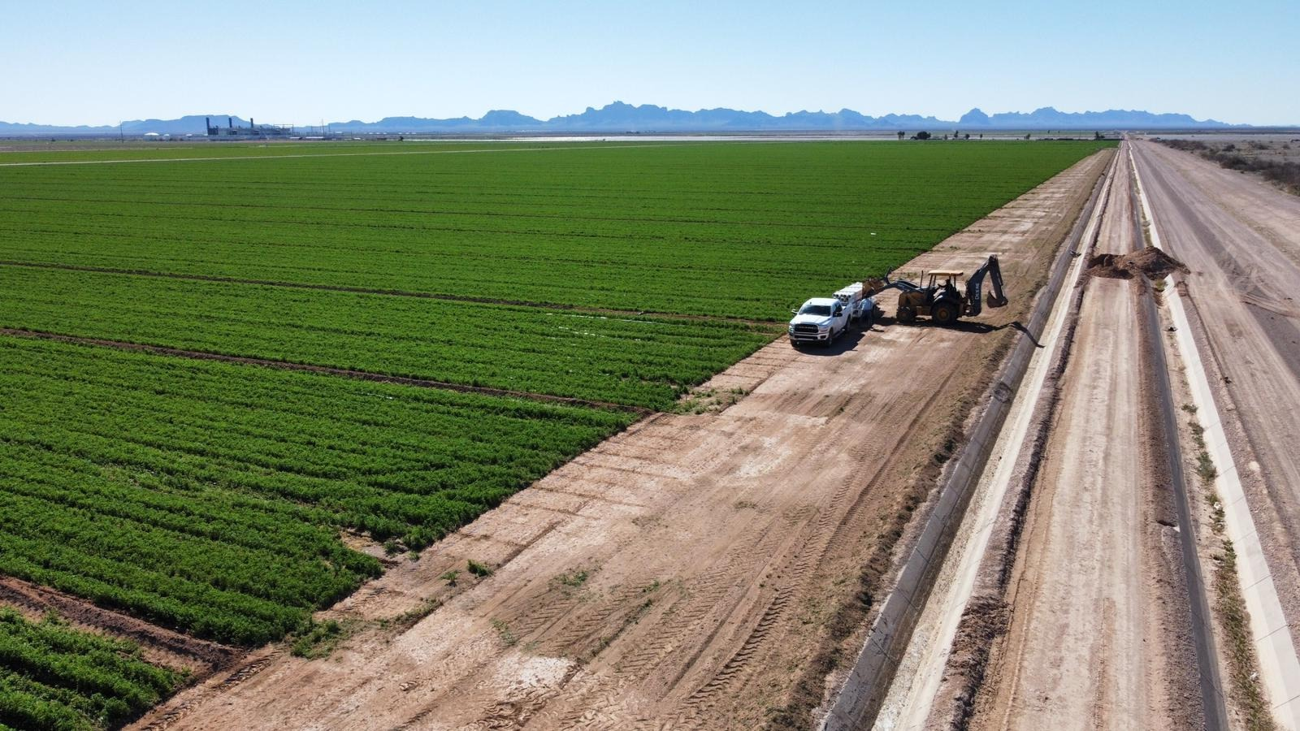
Arizona - Installations & Results
Over 1,500 acres installed
Alfalfa fields showing 49% water savings more than 3 acre-feet per acre

Slide 13

Business Models Responsive to Market Opportunity
Emerging Water Shortage Driver*
Sustainable Supply Chain Driver
1. Water savings sales:
  Water savings solutions to water utilities
  Offsetting water savings
  Public grants-based sales
Strategic partnership with
Partnership with Consumer Products
Goods corporates (CPGs)
Harnessing impact-oriented financial institutions
Irrigation distributors
Direct sales to growers
* Current focus is on Southwest US
Proprietary and Confidential. All Rights Reserved.

Slide 14
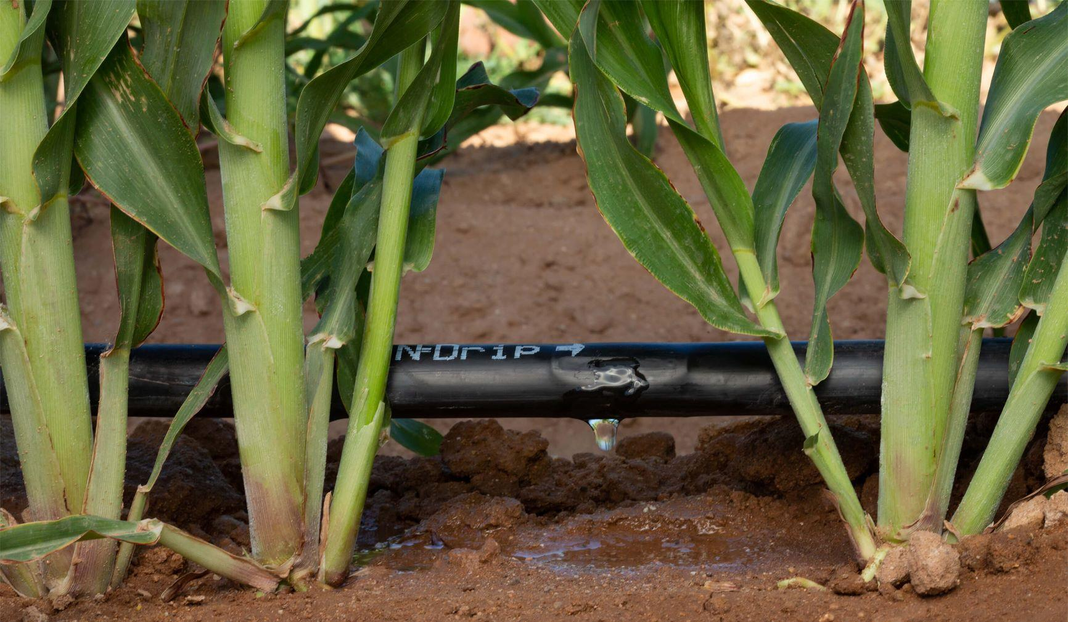
Thank You!
Come N-Drip with Us!
Copyright ©️ 2021 N-Drip. All Rights Reserved. Reproduction and distribution without N-Drip's written permission is prohibited.

